Slide 1
Leveraging Large Language Models to Uncover Environmental Risk Factors for Young Adult Breast Cancer
Rosemary M Danaher
IRB- FY2024-267
Dissertation Advisor: Dr. E Linder

Slide 2
“We are losing too many of our young women to breast cancer because they cannot obtain a timely diagnosis”
Ricki Fairley – CEO, Black Breast Cancer Alliance, Washington, D.C.

Slide 3
Background
1
Why a focus on young adult breast cancer (YABC) makes sense now
The role of risk assessment in determining level and frequency of breast cancer screening
Current breast cancer risk models; why they fall short, especially for young women and why this matters

Slide 4
Breast Cancer – Key Facts
Breast cancer is the most common invasive cancer and the leading cause of death in women worldwide.
Young age remains a risk factor for poorer survival [1].
Breast cancer in very young women is rare, but it has unique features that are not observed in older patients
Unique Features of Young Age Breast Cancer and Its Management – PMC
The changing global patterns of female breast cancer incidence and mortality | Breast Cancer Research | Full Text

Slide 5
What is Early Onset Cancer?
Early Onset Cancer is cancer occurring before 50. It is associated with substantial mortality and morbidity
A population-based cohort study ** analyzed data from 562,145 early onset cancer patients from 1/1/2010 – 12/31/2019 and found:
  Individuals ages 30 – 39 had the largest increase (19.4%) in early onset cancer diagnoses during this period
  In 2019, early-onset breast cancer incidence cases exceeded all other categories; an increase of ~ 8% during the study period, while the age-standardized incidence rate of cancers in individuals aged 50 years and older decreased over the study period
  **https://jamanetwork.com/journals/jamanetworkopen/fullarticle/2808381

Slide 6
“This is a population [<50] that has had less focus in cancer research and their numbers are getting bigger, so it’s important to do more research to understand why this is happening.”
Paul Oberstein, director of the Gastrointestinal Medical Oncology Program - NYU Langone’s Perlmutter Cancer Center

Slide 7
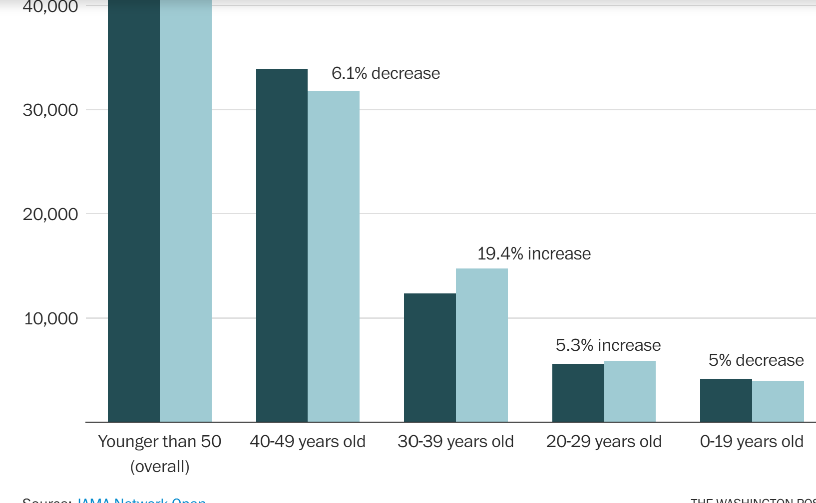






Early Onset Cancer - Percent change over study period, (2010 – 2019) by age group
.74% increase

Slide 8
What is Young Adult Breast Cancer?
Young Adult Breast Cancer, (YABC), is a subset of early onset breast cancer:
  Specifically, Breast Cancer occurring before the age of 40[1]
  Findings from The American Cancer Society are troubling:
    The incidence of invasive breast cancer** diagnoses in U.S. women ages 15 - 39 has been climbing since 2004.
    With an increase of ~3 percent per year from 2000 to 2019. [1] [2]
**https://www.washingtonpost.com/wellness/2023/08/22/breast-cancer-young-women-increase/
[1] https://pubmed.ncbi.nlm.nih.gov/33449828/
[2] https://pubs.rsna.org/doi/full/10.1148/radiol.2021203476
      https://www.washingtonpost.com/wellness/2023/08/16/young-patients-breast-gastrointestinal-cancer/
      https://www.breastcancer.org/research-news/early-onset-cancer-increasing

Slide 9
What is Young Adult Breast Cancer? (contd).
  Of great concern – Most of the increase in the number of invasive YABC cases is attributable to diagnoses of distant disease, meaning the cancer is no longer confined to the breast, (metastatic breast cancer) [1], [2]
    Metastatic breast cancer is much more difficult to treat, and depending on its stage may not be curable.
  [1]https://pubmed.ncbi.nlm.nih.gov/33449828/
  [2] https://pubs.rsna.org/doi/full/10.1148/radiol.2021203476

Slide 10
“Studies such as the one in JAMA, motivate new studies to help identify risk factors that may be able to explain these trends.”
Hyuna Sung – Senior Principal Scientist and Cancer Epidemiologist - American Cancer Society
THIS IS THE GOAL OF MY RESEARCH

Slide 11
Why are these YABCs often metastatic at time of diagnosis?
  YABCs often present with much more aggressive subtypes [2], [3]
  Doctors often miss YABC; PCPs are not looking for the disease in young people [3] *
  YABCs are often found by the patients themselves resulting in more advanced tumors than women with screening-detected tumors [2]
  YABC cells have higher levels of KI-67, a marker of how quickly the cancer cells will divide and spread
  Graphs by age group follow
    [2] https://pubs.rsna.org/doi/full/10.1148/radiol.2021203476
    [3] Unique Features of Young Age Breast Cancer and Its Management – PMC
    *https://www.washingtonpost.com/wellness/2023/08/22/breast-cancer-young-women-increase/

Slide 12
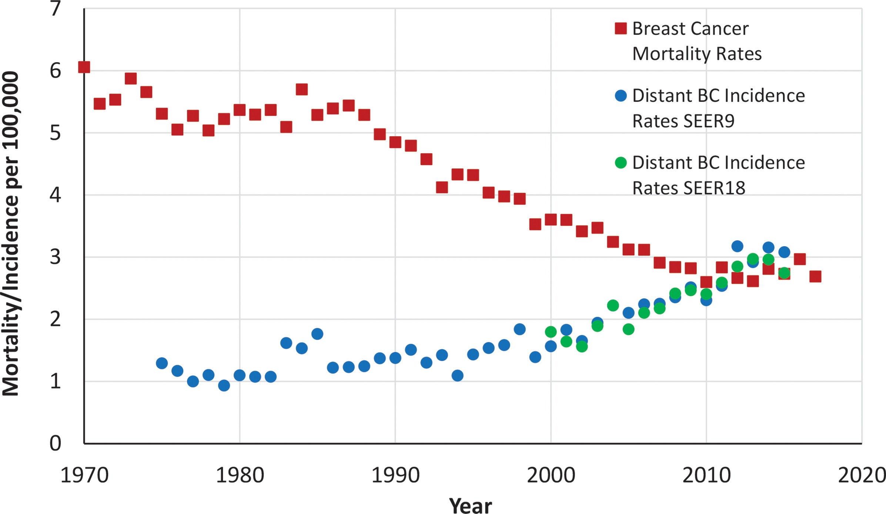
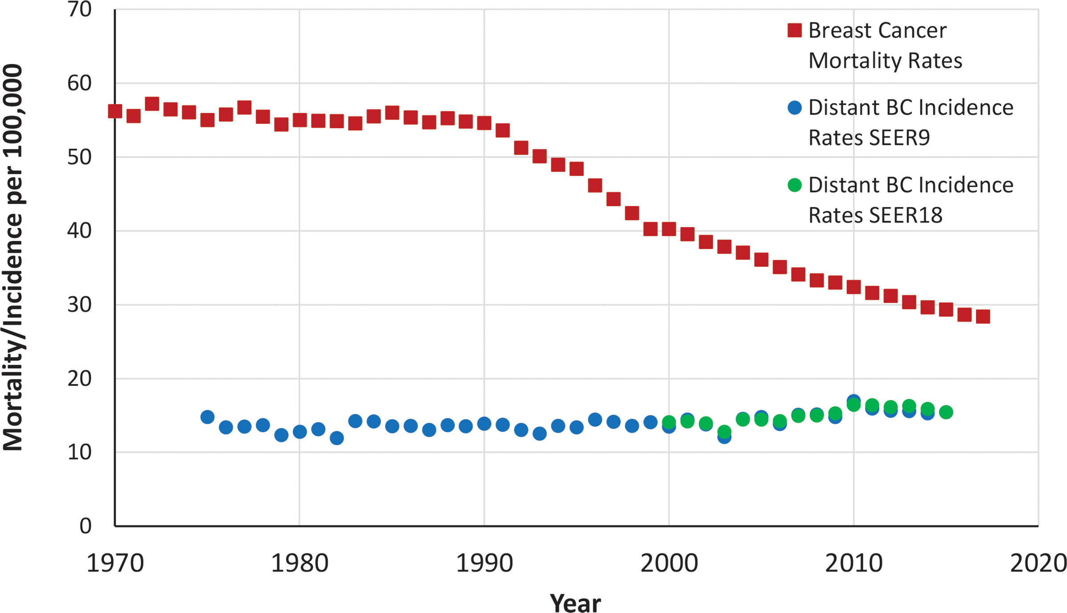

Ages 20 - 39
Ages 40 - 69
Take-aways
Incidence of distant YABC has been rising since about 2000; while remaining relatively flat for ages 40+, with the annual percentage change especially concerning; 4.56% (YABC) vs. 1.2% (40+).
Mortality rates in YAs have flattened out since about 2010, after decreasing annually since ~ 1987.
Hendrick RE. Published Online: February 09, 2021
https://doi.org/10.1148/radiol.2021203476

Slide 13
Why a focus on environmental factors makes sense - The genetics of breast cancer
Mutations in BRCA1/BRCA2 genes are the most common cause of hereditary BC and significantly increase a woman’s lifetime risk (13% in the general population vs. 60%)
However, the prevalence of these mutations in the general population is low, about 1 in 400 [2]
Amongst YABC patients, these mutations are observed 11.6% – 17%of the time vs. 1.2% to 6.1% across all BC patients.
Key Take-Away – A large proportion of YABC cases have no known genetic mutation.
https://www.cancer.gov/about-cancer/causes-prevention/genetics/brca-fact-sheet#:~:text=Yes.,mutations%20(20%E2%80%9328).
[1] Unique Features of Young Age Breast Cancer and Its Management - PMC

Slide 14
Why a focus on environmental factors makes sense – The genetics of breast cancer
Studies of migrants provided the first solid evidence that environmental (rather than genetic) determinants were responsible for most of the observed international and inter-ethnic differences in breast cancer incidence.
The changing global patterns of female breast cancer incidence and mortality | Breast Cancer Research | Full Text

Slide 15
Mammograms for breast cancer screening– Are they useful? It depends.
Screening mammograms have contributed to the mortality decline among women age 40+
They have not contributed to a change in the mortality rate among women < 40 and thus are not recommended for this age group as a general screening tool
  High incidence of dense breast tissue drives high false positive rates
  In a theoretical population of 10 000 women, 35–39:
    16 cancers will be detected
    1250 women will receive a false-positive result.
https://pubs.rsna.org/doi/full/10.1148/radiol.2021203476
Unique Features of Young Age Breast Cancer and Its Management – PMC
Performance of First Mammography Examination in Women Younger Than 40 Years | JNCI: Journal of the National Cancer Institute | Oxford Academic

Slide 16
Mammography guidelines – Dictated by risk assessment
With this background, The U.S. Preventive Services Task Force (USPSTF) has established the following recommendations:
Average risk- Get a mammogram every two years from ages 40 - 74.
High risk - Follow their doctor's advice on screening age and frequency. High-risk women include those who have:
  Had breast cancer
  Carry genetic mutations that increase cancer risk (or have multiple first-degree relatives with breast cancer)
  Had high-risk breast lesions on previous biopsies
  Experienced high-dose chest radiation before age 30

Slide 17
Would the majority of YABC cases have met this criteria, and thus gain access to screening?
Discussion – Interview data gathered from YABC patients raises important concerns about ‘high’ risk assessment in this age group. Specifically:
  Many YABCs are being found by the patient themselves with no report of prior high-risk breast lesions
  Many YABC patients report no familial history. This is consistent with the earlier fact that at most 20% of YABC patients are found to have a BRCA1/2 gene mutation.
  Key Take-Away – The assessment of high risk, especially for women < 40 appears to be flawed and is preventing young women from getting the important BC screening they need.

Slide 18
“As we continue to do better at identifying people who are at higher risk at younger ages, we really need to adjust our screening practices as well.”
Jennifer Litton, Breast Medical Oncologist - University of Texas MD Anderson Cancer Center

Slide 19
The Underlying Challenge:
“To identify environmental risk factors that are associated with young adult breast cancer to ensure we can identify and monitor those women who will benefit most.”
R M Danaher

Slide 20
Moving beyond the USPSTF Guidelines
A look at Predictive models used to assess BC risk
Aside from the USPSTF guidelines, risk assessment models are employed to assess BC risk, in a two-step process.
Step I – Assess the likelihood of high-penetrance susceptibility genes. If likely, assign risk as high; If no continue with the risk assessment model.
Criteria:
  A personal history of breast cancer, specifically:
    Diagnosed at or below the age of 45
    Diagnosed at or below the age of 60 with Triple Negative BC
    Diagnosed at any age with Ashkenazi Jewish ancestry,
  A family history of BC in a first or second-degree relative satisfying any of the above criteria.

Slide 21
Moving beyond the USPSTF Guidelines
A look at Predictive models used to assess BC risk
Key excerpts from “Performance of Breast Cancer Risk-Assessment Models in a Large, Mammography Cohort” Participants women over 40 ) :
Identifying high-risk women before breast cancer develops remains a pressing goal.
Many models have been developed yet they are NOT widely implemented to guide screening decisions in routine clinical settings….partly due to lack of clarity on which risk model to use, limited accuracy of risk models, and time needed.
Key Findings - Model discrimination is only modest. This, coupled with the time and difficulty of obtaining risk factors (family history, genetic markers, breast density) have led to limited adoption of breast cancer risk-assessment models outside of high-risk clinics. https://pmc.ncbi.nlm.nih.gov/articles/PMC7225681/

Slide 22
BC Risk Assessment Models used today https://www.ncbi.nlm.nih.gov/pmc/articles/PMC7100774/ Assessing Risk of Breast Cancer: A Review of Risk Prediction Models - PMC (nih.gov)
Model | Population | Exclusion Criteria | Strengths | Weakness
Modified Gail/BCRAT (circa 1989) | White US women (no participants under age 35) | Under 35; prior invasive BC; known genetic mutation, other exclusions | Readily available; simple; One of only models available to assess eligibility for chemoprevention | Limited use in women of non-white ethnicity
BCSC (2008) breast cancer surveillance consortium | Women in US | Under 35; prior invasive BC, other exclusions | Readily available; simple. | Mammographic breast density must be known
Rosner-Colditz (1996) | Nurses’ Health Study (US) | Prior breast cancer | Includes modifiable risk factors; such as alcohol consumption; BMI | Modest discriminatory statistics
Tyrer-Cuzick/IBIS (2004) | Europe/Australia/New Zealand | None | Can be used in women < 35 | Requires detailed family history

Slide 23
BC Risk Assessment Models used today
Model | Population | Exclusion Criteria | Strengths | Weakness
Claus (1991) | White US Women | No family history of breast or ovarian cancer | Includes paternal family history and ovarian cancer data | does NOT include nonhereditary risk factors; results in tables vs. software vary
BRCAPRO (1997 – 2011) | Women in US | NONE | Best for high-risk women based on family history | Does not include nonhereditary risk factors
BOADICEA(2002) (Breast & Ovarian Analysis of Disease Incidence & Carrier Estimation Algorithm) | East Anglican Cancer Registry | NONE | Best for high-risk women based on family history | Requires detailed family history and software
Myriad II (1998) | Patients with gene sequence analysis | No personal or family history of BC or ovarian cancer | Best for high-risk women based on family history | Incorporates risk from up to 2 relatives

Slide 24










BC Risk Assessment Models used today
A troubling finding for Young Adult Women
An excerpt from Table 2 (Clinical Applications of Risk Prediction Models for Breast Cancer), from the study Assessing Risk of Breast Cancer: A Review of Risk Prediction Models – PMC
Risk Factors | Appropriate Models | Not Appropriate
No known family history | Gail/BCRAT, BCSC, Tyrer-Cuzick | Claus, BRCAPRO, BOADICEA, Myriad II
Under 35 years | Tyrer-Cuzick, Claus, BRCAPRO, BOADICEA | Gail/BCRAT, BCSC
~ 70% of YABC cases have no known family history and are < 35, leaving only the Tyrer-Cuzick model, which did not include American women in the cohort.
Key Take-away – There is no applicable risk assessment model for the majority of US women who will present with YABC.

Slide 25
Moving Forward - A Novel Approach
Using LLMs to identify environmental risk factors
2
  LLMs - Employed in Healthcare and Research
  Current Models use decontexualized data, resulting in the loss of valuable information and insight
  Study Design
  Basic Proof of Concept
  Challenges
  Where we are right now

Slide 26
Why Large Language Models could be Useful in the search for YABC Risk Factors
The use of LLMs in Healthcare and Research
Healthcare
Natural Language Processing (NLP) and AI-based tools can help speed the analysis of health records and medical research papers, making better-informed medical decisions possible, or assisting in the detection or even prevention of medical conditions.
What Is NLP (Natural Language Processing)? | IBM

Slide 27
Why Large Language Models could be Useful in the search for YABC Risk Factors
The use of LLMs in Healthcare and Research
RESEARCH
LLMs offer significant utility in research.
LLMs can greatly streamline literature reviews by efficiently sifting through medical literature and synthesizing succinct summaries from each….
Researchers can distill key insights from a multitude of studies, facilitating a deeper understanding of prevalent themes and emerging trends.
LLMs are able to utilize domain knowledge to assign win/loss to pairs of surveyed responses
https://pmc.ncbi.nlm.nih.gov/articles/PMC11396764/#:~:text=Large%20Language%20Models%20(LLMs%20have,challenges%20like%20hallucinations%20and%20biases
https://papers.ssrn.com/sol3/papers.cfm?abstract_id=5112677

Slide 28
Study Design and use of LLMs
A description of the study design follows. The role of the LLM includes:
            Feedback in constructing interview prompts (completed)
        Analysis of essays from NYTimes BC survivors to validate approach. (completed)
            Comparing 1740 pairs of interview transcripts. (60 participants comprised of 30 sister pairs, results in 60C2 = 1770 pairs, less 30 sister pairs). The LLM will assign a win (first lifestyle more risky)/loss (second lifestyle more risky)/tie to each pair based on the interview transcripts. Note - Retrieval Augmented Generation (RAG) techniques will be used to incorporate the most current research on YABC into the LLM knowledge base. (Currently researching how to implement RAG using the Langchain architecture)

Slide 29
Study Design and use of LLMs – contd.
        The win/loss/tie data will be used to fit a frequentist Bradley-Terry logistic regression model. This model will allow us to compute the probability that participant i has a riskier lifestyle than participant j, denoted, p_{i,j}
        To simulate the population of all possible pairs, many samples of n/2 pairs will be randomly selected from the collection of 1740 pairs. The BT model will be used to compute a p_{i,j} for each pair.
        This large collection of p_{i,js} will then be used to define the null distribution.
            A p_{i,j} will then be computed for each sister pair, and its location within the null distribution of p_{i,js} will then be analyzed to assess nearest neighbors and relative placement within the null distribution.

Slide 30
Study Design and use of LLMs – contd.
            If the LLM assigned appropriate win/loss/ties to the 1740 pairs of transcripts the pij’s for the sister pairs should result in values close to 1. In addition:
            The clustering of transcripts will be examined to identify what details within the transcripts are driving the clustering. This information can be critical in identifying new risk factors.
            Status - Some preliminary R scripts have been created for running the Bradley-Terry model).

Slide 31
Study Design
Recruit biological sister pairs, 18+ years of age, that satisfy the following:
                One diagnosed with young adult breast cancer the other free of cancer
                No known presence of BRCA1/BRCA2 gene mutations
                No strong familial history of breast cancer
                Note: This criteria helps ensure the cancer is not from a genetic mutation.
                Status - Recruitment is proceeding very slowly
                I will discuss my research on the TOUCH Facebook channel on 8/6. TOUCH has also agreed to display my recruitment poster on their social media
                Other organizations currently promoting study:
                The Rex Mobile Mammography clinic in Raleigh
                Alease, the embryologist in Raleigh
                The Empire Dragons rowing team in NYC

Slide 32
Study Design
              Conduct individual online interviews, ~30 – 45 minutes, with a co-moderator. A prompt script will ensure key areas are addressed. The interviews will be recorded on Zoom and transcribed.
              These narratives will then be analyzed using OpenAI GPT-4o as described earlier.

Slide 33
Basic Proof of Concept – Completed in 2024
            Obtained permission from NYTimes to use published essays written by BC survivors.
            Selected 10 essays from women under 40
            Gained access to OpenAI GPT4.0 – turbo to become familiar with key features.
            Completed Prompt Engineering class (Vanderbilt University via Coursera) to gain skill in constructing prompts when working with LLMs.
            The LLM was used to summarize these essays, highlighting key similarities and key differences.
            Several instances of ‘hallucination’, were observed, which the LLM corrected once I brought it to ‘its’ attention.
            While this is subjective, the summaries were very consistent with the essays.

Slide 34
Basic Proof of Concept – LLM Summary
            User
            Let us now proceed by synthesizing the findings of the 10 essays you reviewed. Remember that our final goal is to identify the top 4 similarities and the top 4 differences across these 10 essays.
            Assistant
To synthesize the findings from the ten essays and identify the top four similarities and differences in the experiences of women with breast cancer, let's condense the themes and observations:

Slide 35
Basic Proof of Concept – LLM Summary
### Top 4 Similarities Across the Essays:
1. **Impact of Family and Social Support**: Nearly all essays highlighted significant support from family and friends as pivotal in coping with their diagnosis and treatment. Supportive networks provide emotional and sometimes physical support, illustrating the universal need for close human connections during health crises.
2.**Psychological and Emotional Resilience**: Each narrative underscored the mental and emotional strength required to face cancer. Whether through turning to blogging, creating bucket lists, or redefining personal identities, these women displayed profound resilience and a determination to maintain control over their lives despite their illness.
3. **Proactive in Treatment and Health Decisions**: Many women portrayed took immediate action upon symptom discovery or diagnosis, and were heavily involved in deciding their treatment plans. This proactive approach was often linked to better outcomes and greater satisfaction with the treatment process.
            4. **Life Perspective Shift**: The experience of breast cancer led to significant shifts in how these women viewed their lives—often valuing everyday moments more and undergoing personal transformations. This shift frequently resulted in a deeper appreciation for life and redefined priorities.

Slide 36
Basic Proof of Concept – Completed in 2024
### Top 4 Differences Across the Essays:
1. **Stage at Diagnosis and Disease Management**: The stage at which cancer was diagnosed varied significantly, from early detected to advanced stages. This difference impacted the treatment options available, the urgency of interventions, and the psychological burden, with late-stage diagnoses typically resulting in more aggressive treatments and increased morbidity.
2. **Personal and Family History of Cancer**: Some women had a strong familial history of cancer, which influenced their surveillance and psychological preparedness, while others were taken by surprise with no prior family history, affecting their initial reaction and adaptation to the diagnosis.
3. **Outcome and Future Outlook**: The long-term outlook and personal outcomes post-treatment showed variability. Some women experienced recurrences that led to ongoing challenges, while others were declared cancer-free and focused on recovery and returning to normalcy.
4. **Role of Creative and Expressive Outlets**: The use of creativity and expression as a coping mechanism varied—some women engaged deeply with blogging, writing, or other creative outlets as part of their therapy, while others focused more on physical re-engagement like yoga or work.

Slide 37
Challenges
The single most challenging aspect of this research has been getting data.
                The original study design proposed leveraging data from existing studies.
        A collaborative effort with UNH research librarians and an exhaustive look at several large prospective studies (Sister Study, California Teacher’s Study, Danish Twin Study) concluded that this data did not exist in the public or private domain.

Slide 38
Challenges (Contd).
      Forcing the decision to collect data, with IRB approval.
      The second biggest challenge - Getting participants. This has been seriously hindered by the absence of funding.
      There has been no interest in a raffle drawing with a chance to win 1 of 10 $100 gift cards.
              Specifically, posters distributed to several doctors’ offices, medical conferences, mammography clinics and shops, in and around Boston yielded no responses.
                Discussions with hospital administrative staff were unproductive, identifying prohibitive costs and the need for interval IRB approval.
                Recruitment strategy recently modified to include monetary incentive of $50 per participant.

Slide 39
Moving Forward
      Contacted multiple organizations recently who are interested in assisting; These include:
        Touch
        Empire Dragons
        Rex Mobile Mammography
        Alease – The embryologist
        Changes from original design include:
          Utilize interviews rather than short essays.
          Include an African-American co-moderator; She will soon complete IRB training .
          Payment to participants
          Currently awaiting IRB approval of prompts, Mock interviews to follow
      Interviews – Target start date – August 15th and conclude around Sept. 15th.
      Data analysis will continue through the fall.

Slide 40
Acknowledgements
I would like to thank the following individuals who have generously given of their time and expertise as well as provided resources and encouragement.
Professor Andrew Coppens (UNH) - For his guidance and materials on structuring qualitative interviews.
Ricki Fairley, CEO, Touch – For returning my initial phone call, when I was nothing more than an unknown person with an idea. For her continued interest in my work, her candid feedback and her critical support in identifying potential participants
Professor Pei Geng (UNH) For her inputs and patience as we explored potential areas of research
My Dissertation Advisor, Professor Ernst Linder, Emeritus (UNH) - For agreeing to serve in this important role. For his patience and steadfastness as we formulated possible plans forward over the past 15+ months, while keeping me focused and realistic in my objectives

Slide 41
Acknowledgements (Contd.)
Professor Chau-Wai Wong (Computer Engineering NCSU) – For his enthusiasm in my interest in utilizing LLMs, his guidance over the past 10+ months in this area and his graciousness in allowing me access to his OpenAI lab at NCSU.
Professors GT Ozer, Michelle Capozzoli, and Phil Ramsey (UNH) - For agreeing to be on my advisory committee.
The research librarians and compliance officers at UNH, including Drs. Julie Simpson, Melissa McGee, Susan Jalbert and Molly Hoppa for the many hours they spent answering my queries with regard to the IRB process, Qualtrics and performing data research.

Slide 42
Thanks!
Any questions?
You can find me at:
Rosemary.danaher@unh.edu
rmdanahe@ncsu.edu

